Slide 1
Weather Impact on Coffee Shop Sales
Presented date: 11-01-2025
Presented by : Stanislav Ukrainets

Slide 2
Table of contents
01
02
03
04
05
06
Objective
Key Questions
What data has been used
EDA Analysis
Weather influence on sales
Key Findings and Recommendation

Slide 3
Objective:
Determine how weather conditions (e.g., temperature, precipitation) influence coffee shop and sales patterns to optimize inventory, staffing, and marketing strategies.

Slide 4
Key questions:
Which weather conditions are associated with higher or lower sales?
Are specific products, such as hot drinks, more affected by weather patterns?
How can insights from this data be leveraged to increase sales?

Slide 5
What data has been used:
Sales Data: Collected from our coffee shop’s EPOS system, covering the period from March 1, 2024, to December 23, 2024.
Weather Data: Retrieved from Visual Crossing, a reliable service known for its accurate historical weather data across various locations.

Slide 6
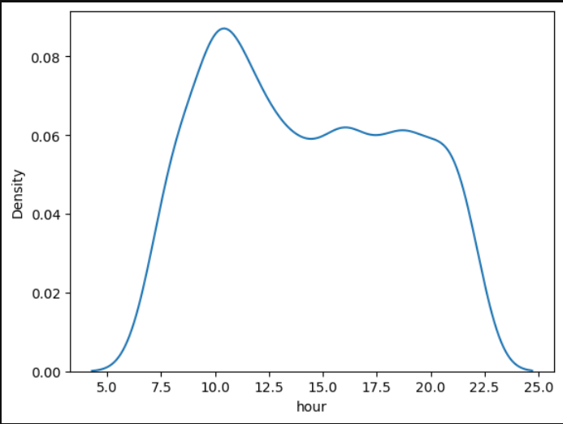
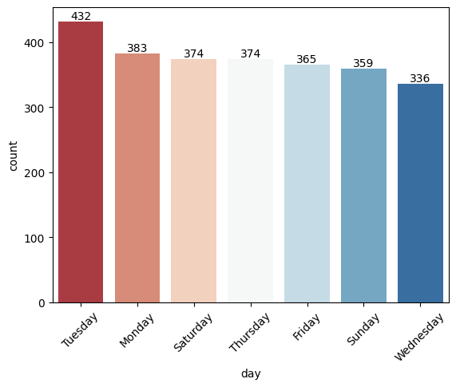
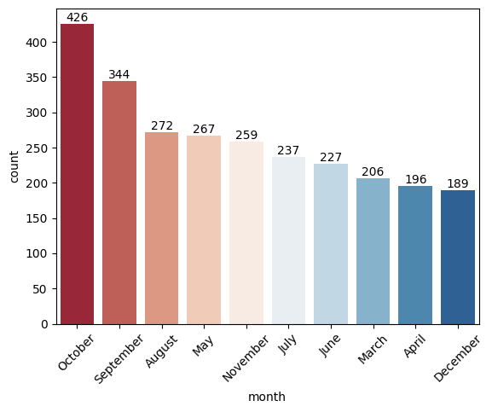
EDA Analysis:
The busiest month is October, followed by September and August, indicating a peak in sales during the autumn season.
The busiest day of the week is Tuesday, while the quietest is Wednesday, suggesting a midweek dip in sales activity.
Most sales occurred between 10 AM and 8 PM, with a noticeable peak at 10 AM, likely due to the morning rush.

Slide 7
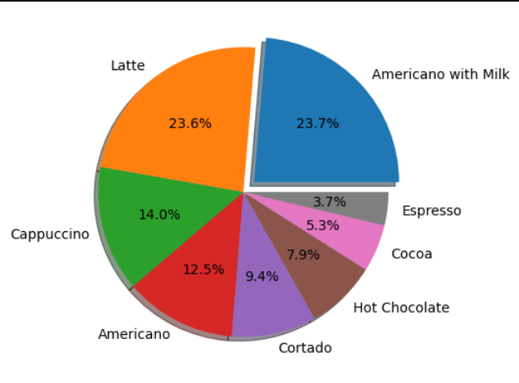
EDA Analysis:
From the following chart, we can see that the most popular drinks are Latte and Americano with milk, accounting for 48% of total sales.
Due to the limited data and the number of products available, this is the key insight regarding product sales. Despite the constraints, this section provides valuable and actionable information.

Slide 8
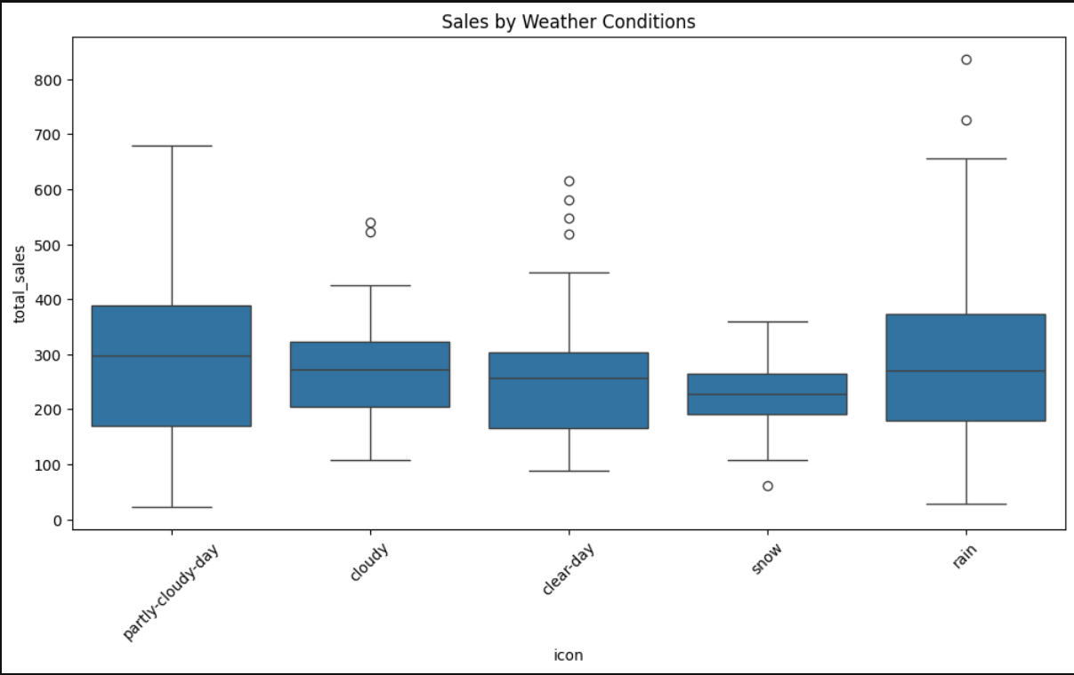
Sales by Weather Condition:
The box plot analysis reveals that the highest sales volumes predominantly occur on rainy and partially cloudy days, followed closely by clear days.
This observation suggests that specific weather conditions, particularly those with rain or partial cloud cover, may have a notable influence on sales activity.

Slide 9
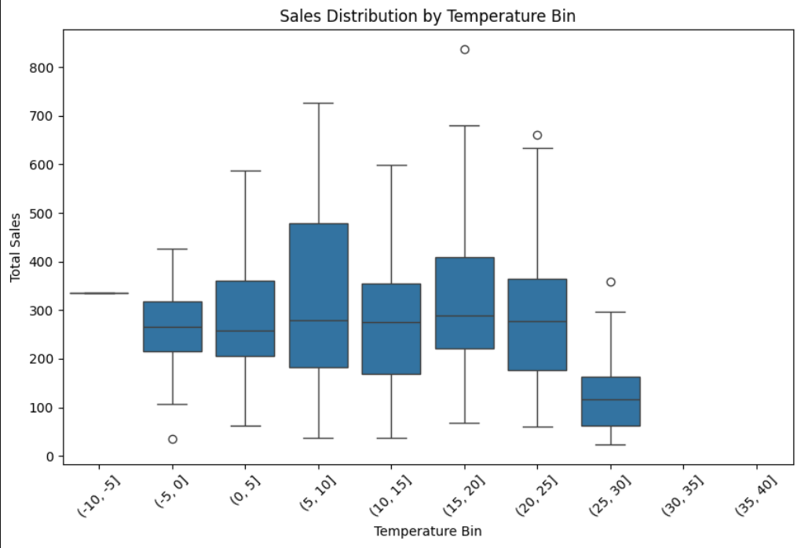
Sales Distribution by Temperature:
The analysis indicates that the highest average sales occurred on days with temperatures ranging between 5°C and 20°C.
This suggests a potential correlation between moderate weather conditions and increased consumer activity or demand.

Slide 10
Key findings :
October is the best-selling month, followed by September and August.
The busiest day of the week is Tuesday.
Sales peak between 8 AM and 10 AM, indicating mornings are the most critical period for business.
Latte and Americano with milk are the most popular items, accounting for 48% of total sales.
Sales are highest on rainy and partially cloudy days, with clear days also contributing significantly.
Current menu options consist solely of hot drinks, leading to lower sales during hotter weather.
Average sales are highest on days with temperatures ranging between 5°C and 20°C.
Sales drop significantly during hotter weather.

Slide 11
Resources
Weather data:
https://www.visualcrossing.com/
Link to the GitHub Project:

Slide 12
Thanks for attention!

